Slide 1
Utilizing Copulas for Simulating Stock Returns Analysis
Anurag Joardar
Debayan Datta
Diptesh Saha
Samapan Kar

Slide 2
What are Copulas?
Copulas are functions that couple multivariate distributions to their marginal distributions.
They allow us to model and understand dependency structures between multiple random variables.
The random variables are independent of their marginal distribution.
Copulas enable us to capture the relationship between variables beyond just the linear correlation.

Slide 3
Why Copulas are important?
Modelling Joint Behaviour: In finance, copulas are used to model the joint behavior of stock returns, which often do not follow a normal distribution.
Limitations of Pearson Correlation: Traditional correlation measures (like Pearson's) fail to capture tail dependencies, which are critical for modeling extreme events in finance (e.g., market crashes).
Advantage of Copulas: Copulas can represent non-linear dependencies and are particularly powerful in capturing tail dependence.

Slide 4
Sklar’s Theorem
This theorem states that any multivariate joint distribution can be expressed in terms of univariate marginal distributions and a copula function.
F(x1, x2, . . . , xd) = C(F1(x1), F2(x2), . . . , Fd(xd)), where:
F(x1, x2, . . . , xd): The joint cumulative distribution function (CDF) of random variables X1, X2, . . . , Xd.
C: The copula function, which captures the dependence structure between the variables.
Fi(xi): The marginal cumulative distribution function (CDF) of the i-th random variable Xi, for i = 1, 2, . . . , d.

Slide 5
Types of Copulas
Gaussian Copula: Often used for modeling symmetric dependencies (captures linear relationships).
Frank Copula: Suitable for modeling symmetric dependencies with potential for extreme events, particularly for data with extreme upper or lower tail dependence.
Clayton Copula: Best for modeling lower tail dependence, i.e., when extreme negative returns tend to occur together.
Gumbel Copula: Ideal for modeling upper tail dependence, where extreme positive returns tend to occur together.
Joe and Ali-Mikhail-Haq Copulas: Other flexible options for capturing specific dependency structures.

Slide 6
How We Use Copulas in the Project
Project Goal: We use copulas to simulate and understand the joint return behavior of stock prices.
Stock Selection: Users can select two stocks and analyze their returns using different copulas (Gaussian, Frank, Clayton, etc.).
Simulation: By simulating returns with the chosen copula, we model the dependencies between the stocks.
Outcome: The project allows users to visualize how copulas can capture the joint behavior and tail dependencies of stock returns, improving insights into their relationship.

Slide 7
To achieve our goal we need to explore and analyze the dependency structure between stock returns using copulas.
How 2 stock returns are related? Capture dependencies
Once dependency is understood, select the copula to use
why understanding dependencies in financial markets is important?
In the real world, stock returns often exhibit complex relationships, including tail dependencies (extreme gains or losses).
Traditional correlation measures like Pearson correlation fail to capture these relationships accurately, but copulas allow us to model them flexibly
exploration and analysis of the dependency structure is the foundation for building a reliable simulation. Without understanding the dependency, the simulation might not accurately reflect real-world behaviors.

Slide 8
Workflow Overview
Step 1: Data Selection and Input
ticker_data.csv containing stock ticker symbols and their names.
fetch historical price data for the chosen stocks using the quantmod package and Yahoo Finance API. The user can also specify the time period (start and end dates)
Step 2: Daily Returns Calculation
$r_{t}=\log{(\frac{P_{t}}{P_{t−1}})}$
$r_{t}$is log return
$P_{t}$is closing price at day 𝑡
Log returns are widely used in finance because they simplify analysis and are additive over time

Slide 9
Step 3: Copula Selection
The user selects the type of copula to analyze the joint dependency structure.
The available copulas include: Gaussian, Frank, Clayton (lower tail dependence), Gumbel (higher tail dependence), Ali-Mikhail-Haq (AMH), Rotated versions (additional flexibility for modeling inversions.
Step 4: Simulation of Returns
After selecting the copula, we simulate new data that reflects the dependency structure between the two stocks.
First, the real log returns are transformed into uniform marginals using the Empirical Cumulative Distribution Function (ECDF).
Then, we apply the chosen copula to simulate correlated uniform samples.
Finally, we map these uniform samples back to the log-return domain using quantiles.
Step 5: Visualization of Results
The real and simulated returns are plotted together for comparison. The application generates:
A scatter plot to visualize the joint behavior of returns.
Marginal distributions (density plots) for each stock’s real and simulated returns to ensure consistency.

Slide 10
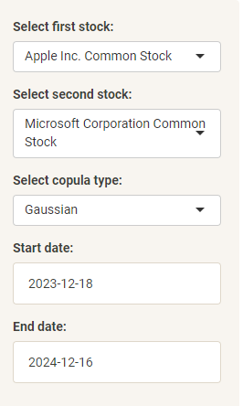
Shiny App Interface and User Interactivity
The app features a sidebar panel for inputs, including:
Stock 1 and Stock 2 selection (e.g., AAPL, MSFT).
Copula type (Gaussian, Clayton, Gumbel, etc.).
Start and end dates for historical data.

Slide 11
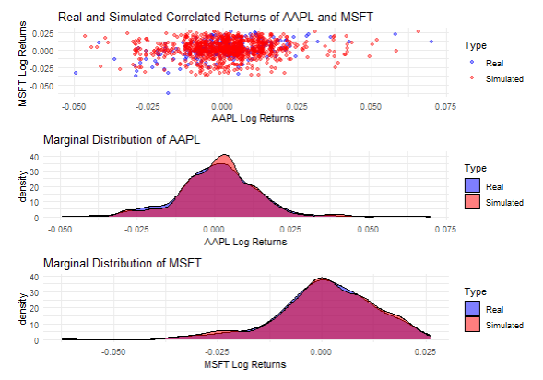
Shiny App Interface and User Interactivity
The main panel displays the results: Correlation information.
Combined plots:
Joint scatter plot of real vs. simulated returns.
Marginal density plots for the two stocks.

Slide 12
Data Transformation – Uniform Marginals
Goal: Copulas require uniform marginal distributions as input.
How it’s done:
Use Empirical Cumulative Distribution Function (ECDF) to transform stock returns into uniform [0,1] space.
Each value in the dataset maps to its corresponding percentile.
This step standardizes the data for copula application while retaining dependency structure.

Slide 13
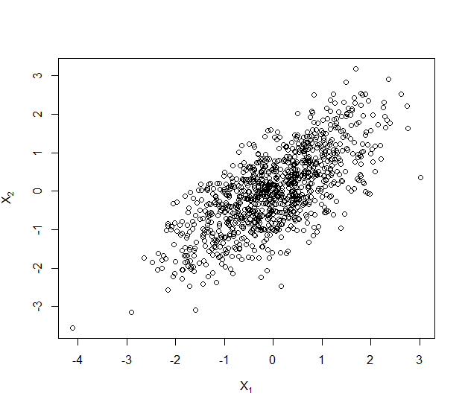
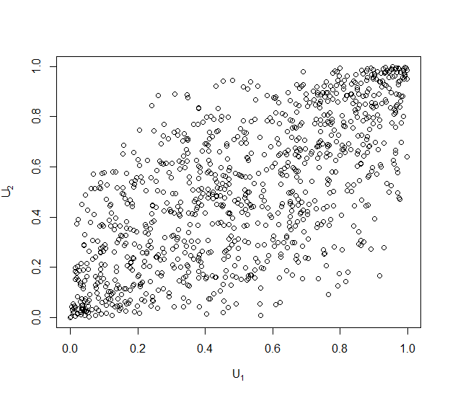
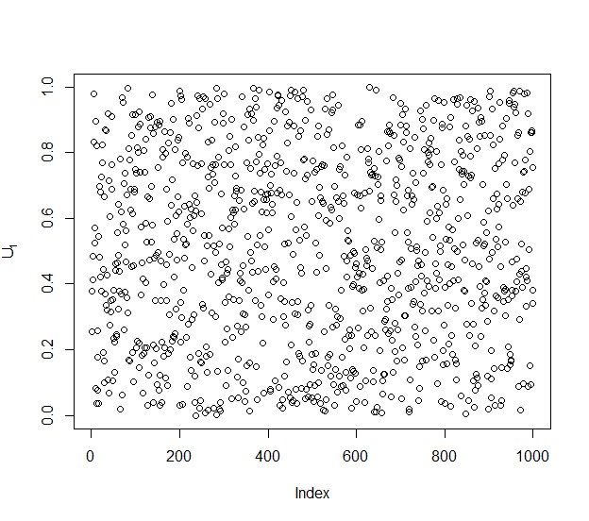
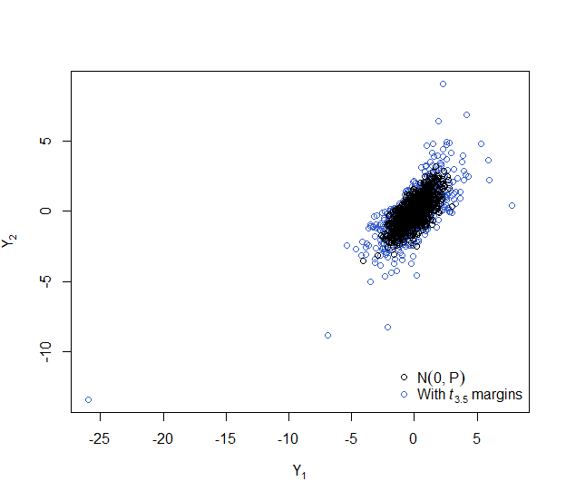
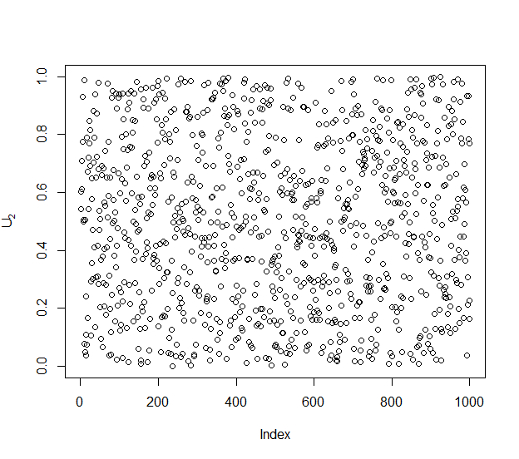
Example (Samples from Bivariate Normal)
Applying ECDF
Mapping uniform margins to a t-distribution
using quantile function with d.f = 3.5.

Slide 14
Choosing Copulas and Parameters
Copula Type | Key Dependency | Parameter Notes | Common Use Cases
Gaussian | Symmetric | Correlation coefficient ρ | Linear dependence
Frank | Strong tail dependence | Parameter θ≥0 | Extreme values
Clayton | Lower tail dependence | θ>0 | Negative extremes
Gumbel | Upper tail dependence | θ≥1 | Positive extremes
Joe | Tail flexibility | θ≥1 | Both tails
AMH | Symmetric | θ∈[−1,1] | Symmetric dependence

Slide 15
Simulating Data with Copulas
rCopula Function:
The rCopula function generates random samples from the copula, ensuring that the samples follow the dependence structure defined by the chosen copula (e.g., Gaussian, Clayton, Gumbel).
Back Transformation:
After generating the uniform samples (in the range of [0, 1]) using the copula, we need to map them back to the original scale of the returns data.
This is achieved using the inverse CDF (also known as the quantile function), which translates uniform samples into real-world values corresponding to stock returns.
Outcome:
The back-transformed values provide us with simulated returns that have the same joint behavior (correlation/ dependence structure) as the original data but are generated synthetically.

Slide 16
Results, Interpretation, and Conclusion

Slide 17
Real vs Simulated Returns
- Scatter plots compare real and simulated returns.
- Real data: clusters along linear trends.
- Simulated data varies based on chosen copula.
- Example: Gaussian copula reflects overall correlation, while Clayton emphasizes joint downturns.

Slide 18
Marginal Distributions
- Marginal distributions ensure individual stock behavior is preserved.
- AAPL may show right-skewed distribution; MSFT might differ.
- Simulated data respects these patterns irrespective of copula type.
- Example: Clayton copula slightly exaggerates extreme negative returns.

Slide 19
Insights Gained
- Dependency structures captured by different copulas:
- Gaussian: Linear dependencies, struggles with extreme events.
- Clayton: Strong lower tail dependence (market crashes).
- Gumbel: Captures upper tail dependence (extreme rallies).
- Applications: Portfolio risk management, options pricing.

Slide 20
Conclusion
- Copulas enhance understanding of dependencies beyond linear correlation.
- Practical skills: Modeling dependencies, visualizing relationships.
- Future Directions:
- High-dimensional copulas for larger portfolios.
- Time-varying copulas for dynamic market conditions.
- Real-world relevance: Essential for risk management and asset allocation.

